Slide 1


Harsh Karekar
July 29, 2025

Slide 2

Outline
Executive Summary
Introduction
Methodology
Results
Conclusion
Appendix
2
Notes:
2

Slide 3
Executive Summary
Objective: Develop predictive models to determine first stage landing success rates using machine learning classification techniques.
Research Process:
Information gathering and data preprocessing
In-depth analytical exploration
Interactive visualization development
Predictive algorithm implementation
Research Outcomes: Visual analysis reveals significant correlations between launch parameters and mission success rates.
Recommended Model: Decision tree classification demonstrates superior performance for Falcon 9 first stage landing predictions.
3

Slide 4
Introduction
Project Background:
This capstone research focuses on developing predictive models to determine the successful recovery of SpaceX Falcon 9 first stage boosters. By leveraging machine learning classification algorithms, we aim to forecast landing outcomes based on various mission parameters and characteristics.
Problems We Solve:
1. How do variables such as payload mass, launch site, and orbit affect landing success?
2. Does the success rate improve over time?
3. What is the optimal algorithm for this binary classification problem?
Strategic Value: This research analyzes public data to predict SpaceX's reusability patterns, enabling cost estimation and competitive analysis in the commercial space industry.
4

Slide 5

Section 1
5

Slide 6
Methodology
Executive Summary
Data collection methodology:
Using SpaceX Rest API
Using Web Scrapping from Wikipedia
Perform data wrangling
Filtering the data
Dealing with missing values
Using One Hot Encoding to prepare the data to a binary classification
Perform exploratory data analysis (EDA) using visualization and SQL
Perform interactive visual analytics using Folium and Plotly Dash
Perform predictive analysis using classification models
Building, tuning and evaluation of classification models to ensure the best results
6
Notes:
6

Slide 7
Data Collection
Our data acquisition strategy employed a dual-source approach combining SpaceX REST API calls and Wikipedia web scraping to ensure comprehensive launch information for thorough analysis.
This hybrid collection method was essential to obtain complete datasets, as neither single source provided all required variables for detailed predictive modeling.
Data Sources & Variables:
1. SpaceX REST API Data Fields:
FlightNumber, Date, BoosterVersion, PayloadMass, Orbit, LaunchSite
Outcome, Flights, GridFins, Reused, Legs, LandingPad, Block
ReusedCount, Serial, Longitude, Latitude
2. Wikipedia Web Scraping Data Fields:
Flight No., Launch site, Payload, PayloadMass, Orbit, Customer
Launch outcome, Version Booster, Booster landing, Date, Time
7
Notes:
7

Slide 8
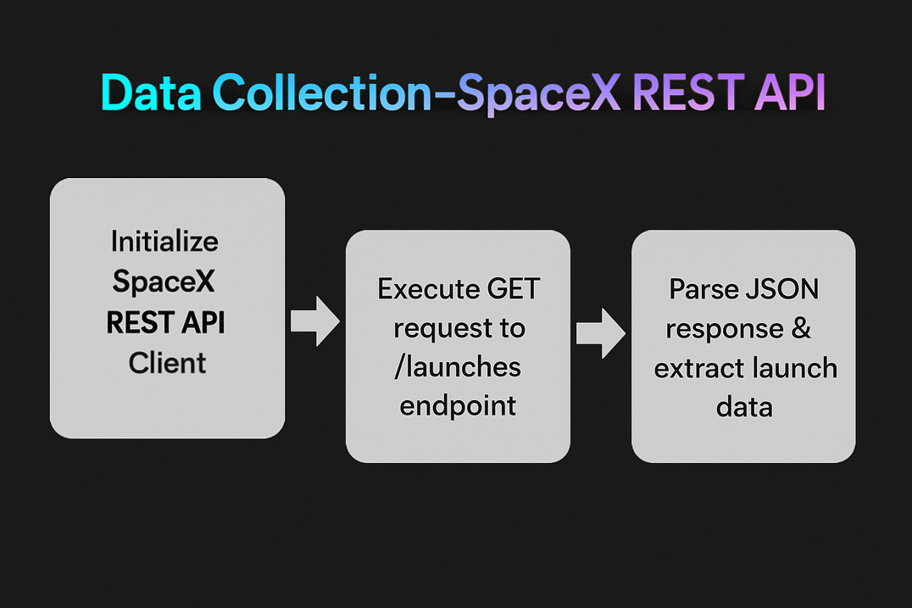
Data Collection – SpaceX API
Key API Data Collection Phrases:
Endpoint Access: GET https://api.spacexdata.com/v4/launches
Authentication: Public API - no authentication required
Response Format: JSON structured data objects
Data Extraction: Parse launch records for mission parameters
Field Mapping: Convert API response to analysis-ready variables
Github link
8

Slide 9
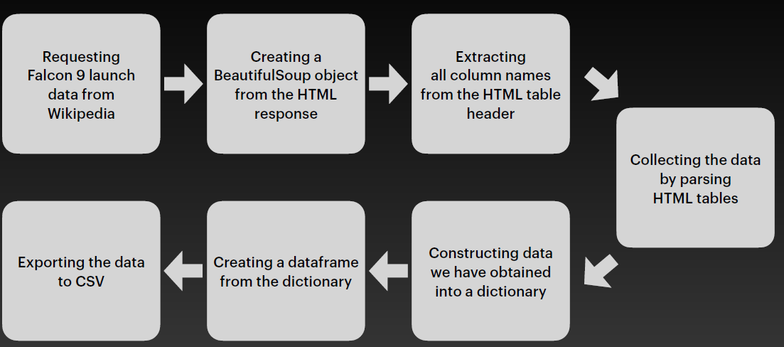
Data Collection - Scraping
Github link
9

Slide 10
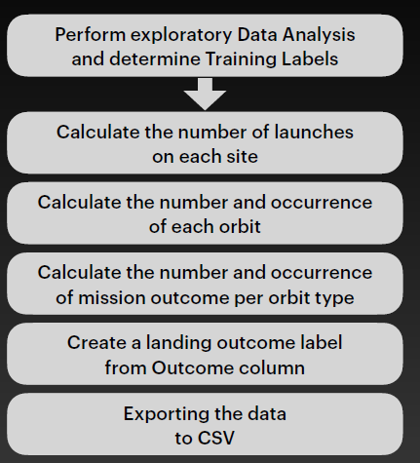
Data Wrangling
Dataset contains multiple SpaceX booster landing scenarios:
Landing Types & Success Indicators
Ocean Landing: Targeted water recovery
True Ocean = Successful ocean landing
False Ocean = Failed ocean landing
RTLS (Return to Launch Site): Ground pad recovery
True RTLS = Successful ground pad landing
False RTLS = Failed ground pad landing
ASDS (Autonomous Spaceport Drone Ship): Sea platform recovery
True ASDS = Successful drone ship landing
False ASDS = Failed drone ship landing
Binary classification system:
"1" = Successful landing (any type)
"0" = Unsuccessful landing (any type)
This standardization enables machine learning model training for landing success prediction
Github Link
10

Slide 11
EDA with Data Visualization
The file presents an exploratory data analysis of SpaceX launch data using three main charts. A category plot was used to display the relationship between Flight Number and Payload Mass, with color indicating the outcome of each launch. This visualization helped illustrate how booster landing success rates changed with increasing flight numbers and with varying payload sizes.
Next, a scatter plot of Flight Number versus Launch Site, also colored by outcome, was employed to compare the distribution and trends of successful and failed landings at different launch locations across time.
Lastly, a line plot was created to show the trend in launch success rates by year, which provided an overarching view on how reliability has evolved annually. Together, these charts were selected to comprehensively explore how booster recovery outcomes are influenced by mission characteristics, launch site, and temporal progression within the SpaceX launch program.
Github Link
11

Slide 12
EDA with SQL
Identified and displayed all distinct launch sites available in the dataset.
Viewed launches with detailed fields
Selected and displayed key columns (e.g., date, booster version, launch site, payload, mission outcome) for initial inspection of mission records.
Calculated total payload mass delivered for NASA (CRS) missions
Filtered launches for NASA Commercial Resupply Services (CRS) missions and summed total payload mass sent.
Computed average payload mass by booster version
Aggregated launches by booster version (e.g., F9 v1.1) and calculated the average payload mass for each.
Found the date of first successful ground pad landing
Queried for the earliest date with a landing outcome classified as successful on a ground pad.
Analyzed successful and failed landings by booster version
Grouped launches by booster version to count and compare the number of successful and unsuccessful landing outcomes.
Retrieved launches by date, booster version, and launch site for 2015
Listed selected details (date, booster, site) for launches carried out in the year 2015.
Summarized landing outcome counts
Counted and displayed the number of missions for each landing outcome type (e.g., no attempt, success, failure), providing a breakdown of how often each scenario occurred.
Github Link
12

Slide 13
Build an Interactive Map with Folium
Map Objects Created:
Color-coded markers - Added individual markers at each SpaceX launch site using latitude/longitude coordinates with green markers for successful landings (class = 1) and red markers for failed landings (class = 0)1
Launch site location markers - Created markers for four main SpaceX launch sites: CCAFS LC-40, CCAFS SLC-40, KSC LC-39A, and VAFB SLC-4E to serve as geographic reference points1
Binary color system - Implemented green/red color scheme for immediate visual identification of landing success patterns across different launch locations1
Purpose & Analysis:
The interactive geospatial visualization revealed location-based patterns in SpaceX booster landing success rates, enabling analysis of whether certain launch sites had higher success rates and identifying geographic factors influencing mission outcomes1. This approach allowed for quick visual identification of success clusters and failure patterns at specific launch facilities.
Github Link
13

Slide 14
Build a Dashboard with Plotly Dash
Plots/Graphs Added
Pie Chart - Shows total successful launches by site (all sites view) or success vs. failure breakdown (specific site view)1
Scatter Plot - Displays correlation between payload mass and launch success with color-coded booster versions and interactive sizing1
Interactive Components
Launch Site Dropdown - Allows filtering between "All Sites" view or specific launch sites (CCAFS, KSC, VAFB)1
Payload Range Slider - Enables filtering data by payload mass range (0-10,000 kg) with 1,000 kg increments1
Purpose & Rationale
Pie Chart Purpose - Provides quick visual comparison of success rates across launch sites and identifies which sites perform better for mission planning1
Scatter Plot Purpose - Reveals payload-success relationships to determine optimal payload ranges and identifies booster version performance patterns1
Dropdown Interaction - Enables site-specific analysis for targeted performance evaluation and comparison studies1
Slider Interaction - Allows payload-based filtering to analyze success rates within specific weight categories for mission optimization1
These interactive visualizations enable comprehensive analysis of SpaceX launch performance across multiple dimensions simultaneously
Github Link
14

Slide 15
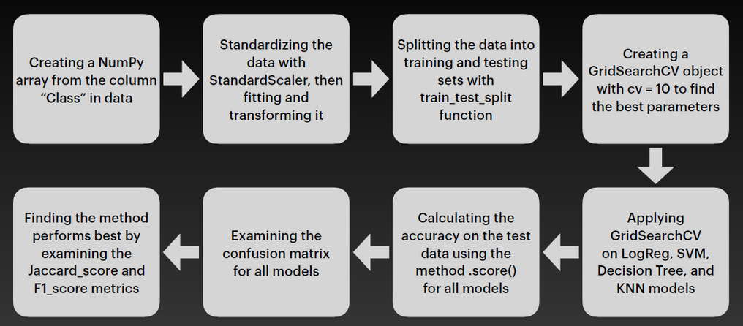
Predictive Analysis (Classification)
Key Steps Taken
Data Preparation
Selected features and target label (Class)
Applied standardization to feature data
Train-Test Split
Split dataset into training and test sets (80/20)
Model Selection & Tuning
Built four classifiers: Logistic Regression, SVM, Decision Tree, KNN
Used GridSearchCV for hyperparameter optimization (10-fold cross-validation per model)
Model Evaluation
Evaluated best-found models by test accuracy and confusion matrix on hold-out data
Model Comparison & Selection
Compared models using validation and test set accuracy
Selected best-performing model: Decision Tree (highest validation score)
Outcome:
Successfully developed and compared four ML classifiers. After comprehensive tuning and evaluation, the Decision Tree showed the highest performance and was chosen as the best model for booster landing prediction1.
Github Link
15

Slide 16
Results
Key Findings
Success Rate Improvement: Significant increase in landing success over time with newer booster versions
Payload Impact: Heavier payloads correlate with lower landing success rates
Site Performance: Launch sites show varying success rates based on mission types
Best Model: Decision Tree classifier achieved highest accuracy for landing prediction
Business Impact: Cost Savings-
$50-60M saved per successful booster recovery
Data-driven payload optimization and launch site selection
Dashboard Features-
Interactive filtering by launch site and payload range
Real-time success rate visualization
Mission planning insights
Conclusion
Successfully developed ML pipeline predicting Falcon 9 landing outcomes with high accuracy. Decision Tree model provides interpretable predictions for mission planning and cost optimization, delivering complete end-to-end solution from data extraction to deployment-ready model.
16
Notes:
16

Slide 17

Section 2

Slide 18
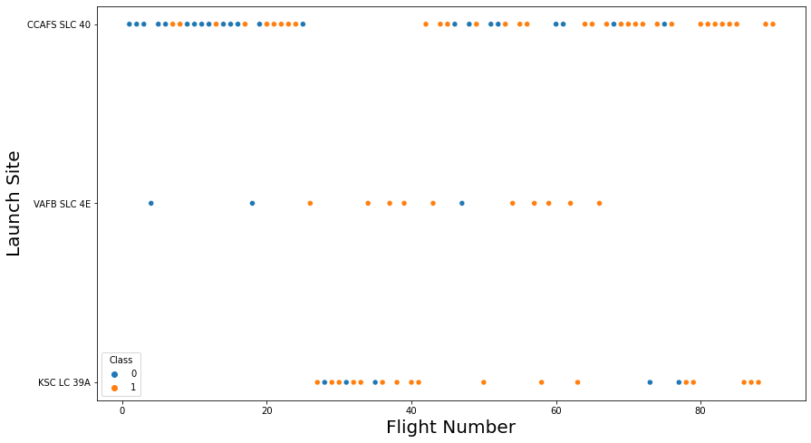
Flight Number vs. Launch Site
Key Observations:
CCAFS SLC 40: Shows the highest launch frequency with missions distributed throughout the flight sequence, displaying a mix of successful and failed landings
VAFB SLC 4E: Limited number of launches concentrated in the middle flight range, with mixed success rates
KSC LC 39A: Launches appear later in the flight sequence with relatively good success rates
Analysis Purpose:
This visualization helps identify patterns in landing success across different launch sites and over time, enabling analysis of whether certain facilities have better infrastructure or conditions that contribute to higher booster recovery success rates. The temporal aspect (flight number progression) also reveals how SpaceX's landing capabilities evolved across their launch program.
18

Slide 19
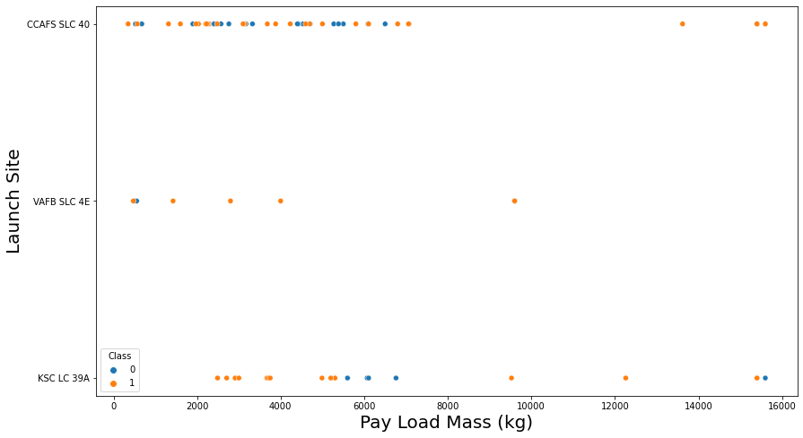
Payload vs. Launch Site
Key Observations:
CCAFS SLC 40: Handles the widest range of payload masses (0-16,000 kg) with the highest launch frequency, showing mixed success rates across different payload weights
KSC LC 39A: Launches concentrated in lower to mid-range payload masses with relatively consistent performance
VAFB SLC 4E: Limited launches with lighter payloads, showing sporadic success patterns
Analysis Insights:
The visualization reveals that heavier payloads (above 10,000 kg) appear to correlate with certain launch sites and success patterns. CCAFS SLC 40 demonstrates the most operational flexibility, handling both light and heavy payloads, while other sites show more specialized payload ranges. This data helps identify optimal launch site selection based on mission payload requirements and expected success rates.
19

Slide 20
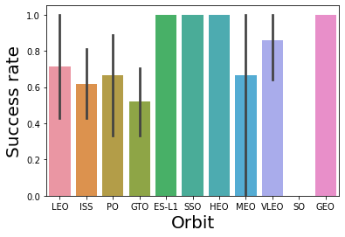
Success Rate vs. Orbit Type
This bar chart shows booster landing success rates for different orbital destinations. Each bar represents the success rate (0-1.0 scale) for missions targeting specific orbits like LEO (Low Earth Orbit), ISS, GTO (Geostationary Transfer Orbit), etc.
Key Insights:
SSO, HEO, MEO show near-perfect success rates (~1.0)
LEO and ISS missions have moderate success rates (~0.7)
GEO missions show the highest success rate
Error bars indicate variability in performance for each orbit type
The chart reveals that orbital destination significantly impacts landing success, likely due to varying fuel requirements and mission complexity for different orbital trajectories.
20

Slide 21
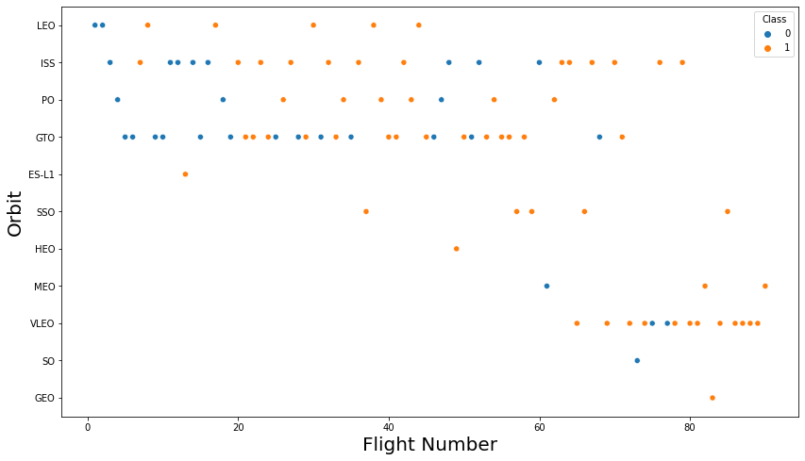
Flight Number vs. Orbit Type
This scatter plot shows SpaceX launch outcomes across flight numbers (mission sequence) categorized by orbit type (LEO, ISS, PO, GTO, etc.). Blue dots represent Class 0 (one outcome type) and orange dots represent Class 1 (another outcome type).
Key Observations:
LEO missions dominate early flight numbers with mixed success patterns
ISS missions cluster in mid-range flight numbers showing consistent performance
GTO missions appear throughout the timeline with varying outcomes
Later flight numbers show more diverse orbit types, indicating SpaceX's expanding mission capabilities
The visualization demonstrates how SpaceX's mission portfolio diversified over time while revealing orbit-specific success patterns across their launch history.
21

Slide 22
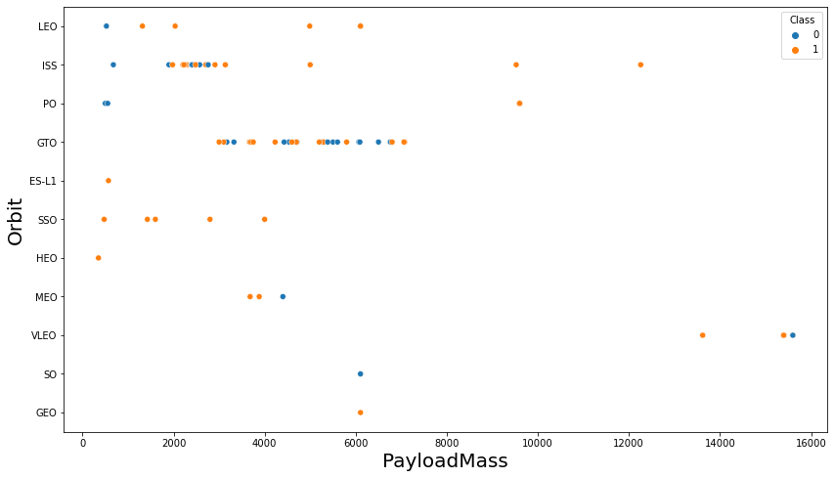
Payload vs. Orbit Type
This scatter plot displays the relationship between Payload Mass (kg) and Orbit Type for SpaceX missions, with color coding showing landing outcomes (blue for Class 0, orange for Class 1).
Key Observations:
GTO missions handle the heaviest payloads (up to ~15,000 kg) with mixed success rates
LEO missions show the widest payload range distribution with varied outcomes
ISS missions cluster around lighter payloads (~2,000-6,000 kg) with consistent performance
SSO, PO, ES-L1 missions handle lighter payloads with generally good success rates
The chart reveals that heavier payloads and certain orbit types (like GTO) present greater challenges for successful booster recovery, likely due to increased fuel consumption requirements.
22

Slide 23
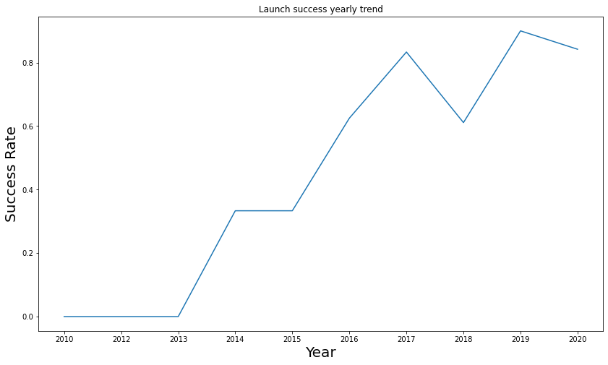
Launch Success Yearly Trend
This line chart shows the evolution of SpaceX booster landing success rates over time from 2010 to 2020.
Key Observations:
2010-2013: Zero success rate - no successful landings during early program years
2013-2014: First breakthrough achieving ~35% success rate
2015: Maintained steady ~35% success rate
2016-2017: Dramatic improvement reaching peak of ~83% success
2018: Temporary dip to ~62% success rate
2019: Recovery to highest point at ~95% success rate
2020: Slight decline to ~85% but still maintaining high performance
The chart demonstrates SpaceX's remarkable improvement in landing technology over the decade, transitioning from complete failure to achieving consistently high success rates above 80% in recent years.
23

Slide 24
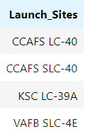
All Launch Site Names
This SQL query extracts all unique launch site locations from the SpaceX database table (SPACEXTBL).
Query Breakdown:
SELECT DISTINCT: Returns only unique values, eliminating duplicate entries
LAUNCH_SITE: The database column containing launch facility names
as "Launch_Sites": Renames the output column for clearer presentation
FROM SPACEXTBL: Specifies the SpaceX data table as the source
24

Slide 25
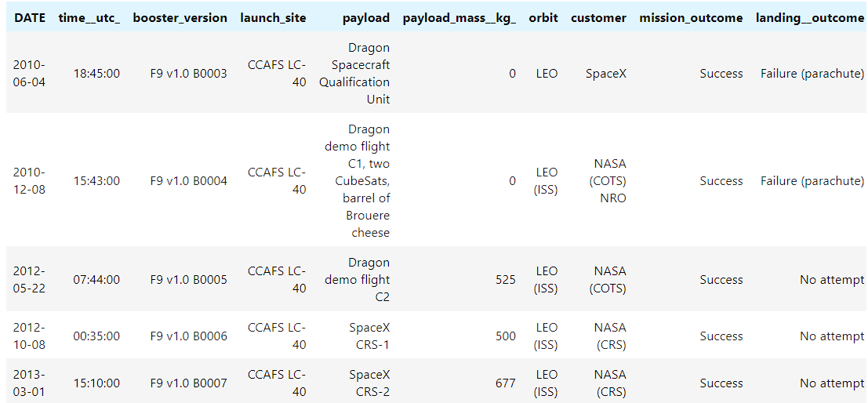
Launch Site Names Begin with 'CCA'
This SQL query retrieves the first 5 launch records from Cape Canaveral Air Force Station facilities.
Query Breakdown:
SELECT *: Returns all columns from the table
FROM SPACEXTBL: Queries the SpaceX database table
WHERE LAUNCH_SITE LIKE 'CCA%': Filters for launch sites starting with "CCA" (Cape Canaveral Air Force Station)
LIMIT 5: Restricts output to only the first 5 matching records
25

Slide 26
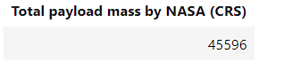
Total Payload Mass
SQL Query Explanation: NASA CRS Total Payload Mass
This SQL query calculates the total payload mass delivered for NASA Commercial Resupply Services (CRS) missions.
Query Breakdown:
SELECT SUM(PAYLOAD_MASS__KG_): Adds up all payload masses in kilograms
AS "Total payload mass by NASA (CRS)": Renames the output column for clarity
FROM SPACEXTBL: Queries the SpaceX database table
WHERE CUSTOMER = 'NASA (CRS)': Filters only for NASA Commercial Resupply Service missions
26

Slide 27
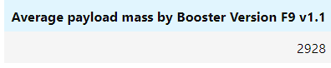
Average Payload Mass by F9 v1.1
This SQL query calculates the total payload mass delivered for NASA Commercial Resupply Services (CRS) missions.
Query Breakdown:
SELECT AVG(PAYLOAD_MASS__KG_): Averages up all payload masses in kilograms
AS “Avrage payload mass by NASA (CRS)": Renames the output column for clarity
FROM SPACEXTBL: Queries the SpaceX database table
WHERE CUSTOMER = 'NASA (CRS)': Filters only for NASA Commercial Resupply Service missions
27

Slide 28
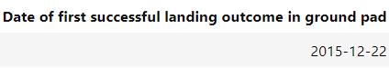
First Successful Ground Landing Date
SQL Query Explanation: First Successful Ground Pad Landing
This SQL query finds the earliest date when SpaceX achieved their first successful booster landing on a ground pad.
Query Breakdown:
SELECT MIN(DATE): Returns the minimum (earliest) date value from the filtered results
AS "Date of first successful landing outcome in ground pad": Renames the output column for clarity
FROM SPACEXTBL: Queries the SpaceX database table
WHERE LANDING__OUTCOME = 'Success (ground pad)': Filters only for missions with successful ground pad landings
28

Slide 29
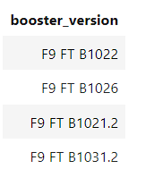
Successful Drone Ship Landing with Payload between 4000 and 6000
This SQL query identifies booster versions that successfully landed on drone ships while carrying medium-weight payloads.
Query Breakdown:
SELECT BOOSTER_VERSION: Returns the booster version identifiers (e.g., F9 v1.1, F9 FT, F9 B4)
FROM SPACEXTBL: Queries the SpaceX database table
WHERE LANDING__OUTCOME = 'Success (drone ship)': Filters for successful ASDS (Autonomous Spaceport Drone Ship) landings
AND PAYLOAD_MASS__KG_ BETWEEN 4000 AND 6000: Further filters for payloads in the 4,000-6,000 kg range
29

Slide 30
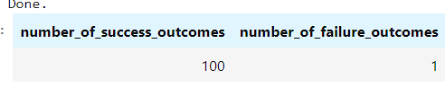
Total Number of Successful and Failure Mission Outcomes
This SQL query provides a comprehensive mission outcome comparison by counting successful and failed SpaceX missions side-by-side.
Query Breakdown:
Two Subqueries with Cross Join:
Success Subquery: COUNT(*) WHERE MISSION_OUTCOME LIKE 'Success%' - counts all missions with outcomes starting with "Success"
Failure Subquery: COUNT(*) WHERE MISSION_OUTCOME LIKE 'Failure%' - counts all missions with outcomes starting with "Failure"
Pattern Matching: LIKE 'Success%' and LIKE 'Failure%' capture variations like "Success (drone ship)", "Failure (parachute)", etc.
Cross Join: Combines both counts into a single row result
30

Slide 31
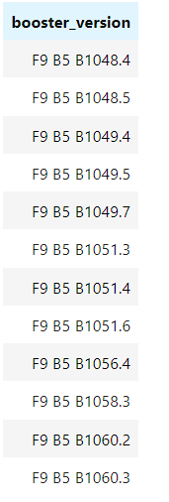
Boosters Carried Maximum Payload
This SQL query identifies which booster version(s) carried the heaviest payload in SpaceX's launch history.
Query Breakdown:
SELECT DISTINCT BOOSTER_VERSION: Returns unique booster version identifiers, eliminating duplicates
FROM SPACEXTBL: Queries the SpaceX database table
WHERE PAYLOAD_MASS__KG_ =: Filters for records matching a specific payload mass
(SELECT MAX(PAYLOAD_MASS__KG_) FROM SPACEXTBL): Subquery that finds the maximum payload mass in the entire dataset
31

Slide 32
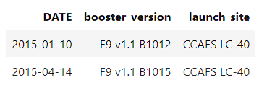
2015 Launch Records
This SQL query retrieves specific mission details for SpaceX launches in 2015 that failed to land successfully on drone ships.
Query Breakdown:
SELECT DATE, BOOSTER_VERSION, LAUNCH_SITE: Returns three key mission identifiers
FROM SPACEXTBL: Queries the SpaceX database table
WHERE year(DATE) = '2015': Filters for missions launched in 2015 using date extraction function
AND LANDING__OUTCOME = 'Failure (drone ship)': Further filters for failed ASDS (drone ship) landing attempts
32

Slide 33
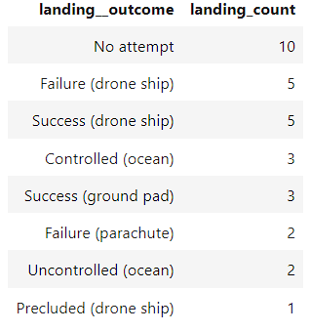
Rank Landing Outcomes Between 2010-06-04 and 2017-03-20
This SQL query analyzes SpaceX landing attempt results during their early development period, ranking outcomes by frequency.
Query Breakdown:
SELECT LANDING__OUTCOME, COUNT(LANDING__OUTCOME) AS Landing_Count: Returns outcome types and their occurrence counts
FROM SPACEXTBL: Queries the SpaceX database table
WHERE DATE BETWEEN '2010-06-04' AND '2017-03-20': Filters for ~7-year period covering early SpaceX missions
GROUP BY LANDING__OUTCOME: Groups records by landing outcome type for counting
ORDER BY COUNT(LANDING__OUTCOME) DESC: Sorts results from most to least frequent outcomes
33

Slide 34

Section 3

Slide 35
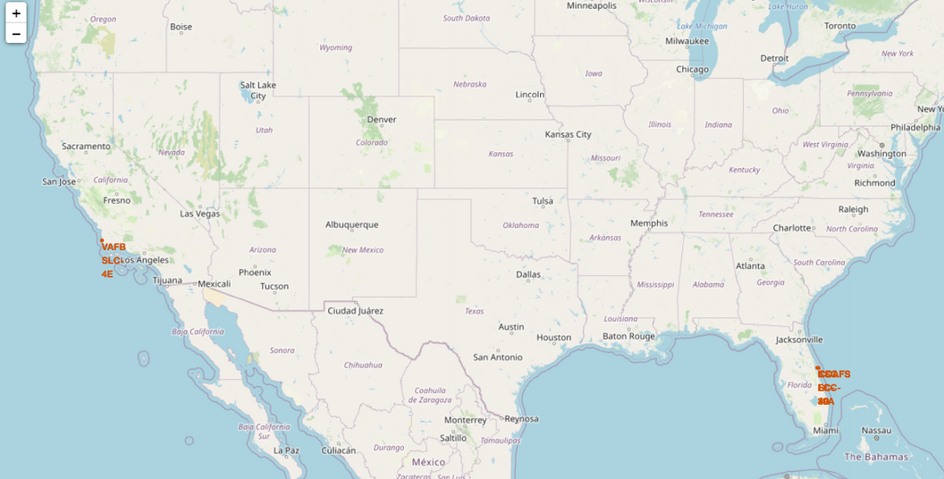
Map with Marked Launch Sites
Explanation:
• Most of Launch sites are in proximity to the Equator line. The land is moving faster at the equator than any other place on the surface of the Earth. Anything on the surface of the Earth at the equator is already moving at 1670 km/hour. If a ship is launched from the equator it goes up into space, and it is also moving around the Earth at the same speed it was moving before launching. This is because of inertia. This speed will help the spacecraft keep up a good enough speed to stay in orbit.
• All launch sites are in very close proximity to the coast; while launching rockets towards the ocean it minimizes the risk of having any debris dropping or exploding near people.
35

Slide 36
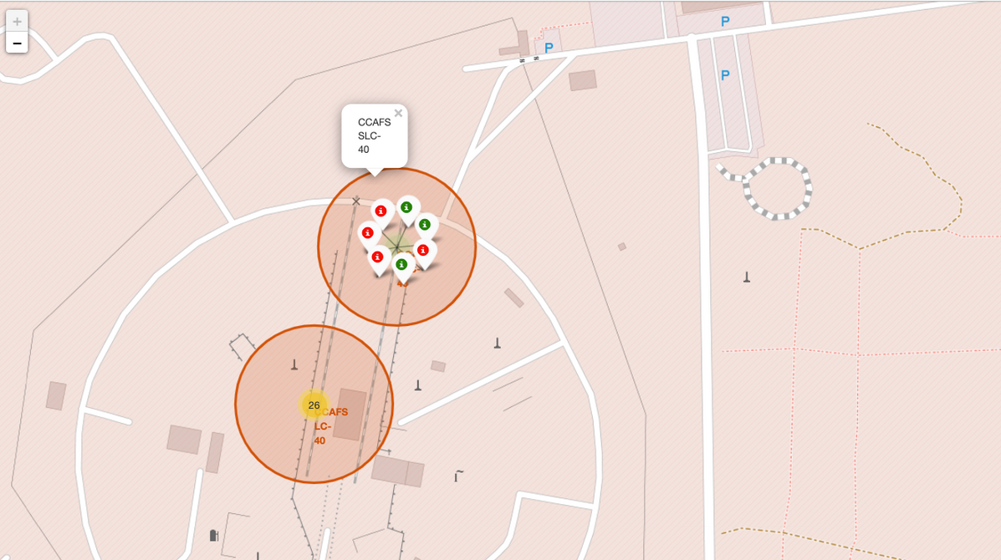
Mark the Success/Failed Launches for Each Site on the Map
Explanation:
• From the color-labeled markers we should be able to easily identify which launch sites have relatively high success rates.
Green Marker = Successful Launch
Red Marker = Failed Launch
• Launch Site KSC LC-39A has a very high Success Rate.
36

Slide 37
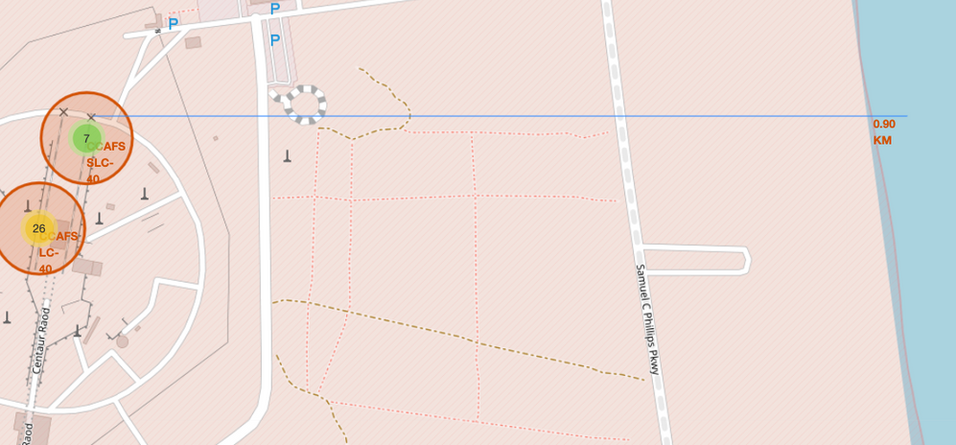
Distance from the Launch Site KSC LC-39A to its Proximities
Explanation:
From the visual analysis of the launch site KSC LC-39A we can clearly see that it is: - relatively close to railway (15.23 km)
relatively close to highway (20.28 km)
relatively close to coastline (14.99 km)
Also, the launch site KSC LC-39A is relatively close to its closest city Titusville (16.32 km).
Failed rocket with its high speed can cover distances like 15-20 km in few seconds. It could be potentially dangerous to populated areas.
37

Slide 38

Section 4

Slide 39
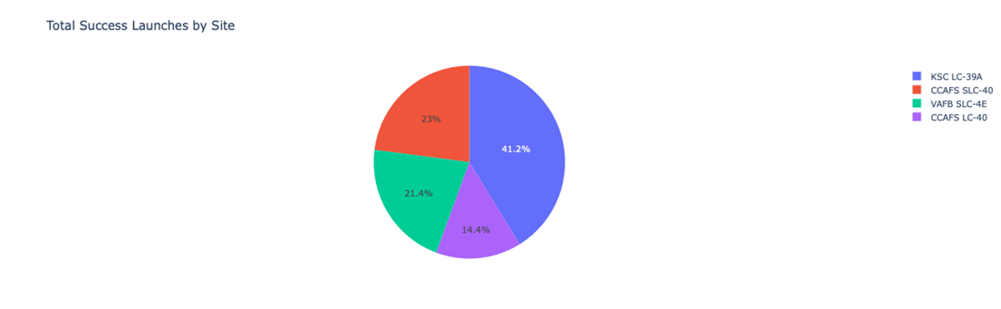
Launch success count for all sites
Explanation:
• The chart clearly shows that from all the sites, KSC LC-39A has the most successful launches.
39

Slide 40
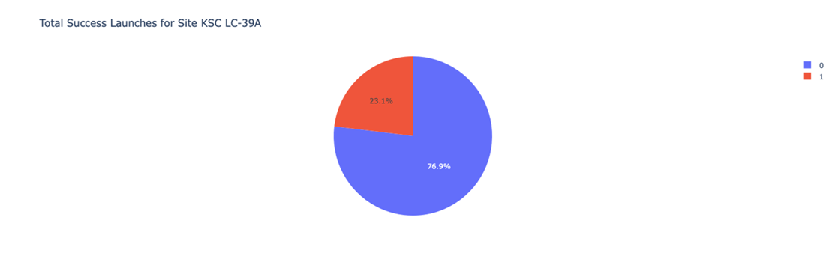
Launch Site with Highest Launch Success Ratio
Explanation:
• KSC LC-39A has the highest launch success rate (76.9%) with 10 successful and only 3 failed landings.
40

Slide 41
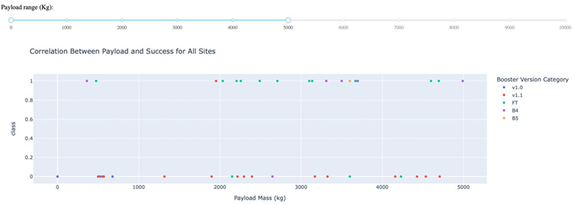
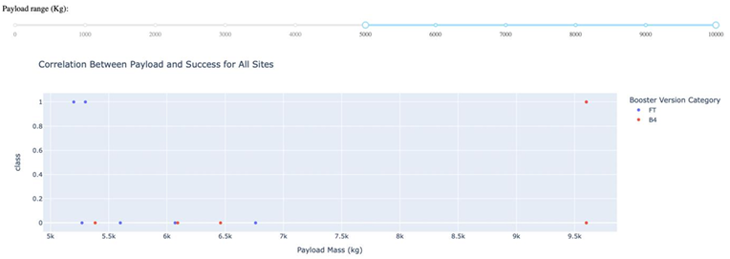
Payload Mass vs. Launch Outcome for All Sites
Explanation:
• The charts show that payloads between 2000 and 5500 kg have the highest success rate.
41

Slide 42

Section 5

Slide 43
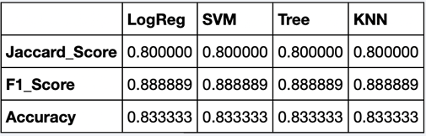
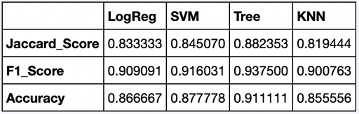
Classification Accuracy
Explanation:
Based on the scores of the Test Set, we can not confirm which method performs best.
Same Test Set scores may be due to the small test sample size (18 samples). Therefore, we tested all methods based on the whole Dataset.
The scores of the whole Dataset confirm that the best model is the Decision Tree Model. This model has not only higher scores, but also the highest accuracy.
Scores and Accuracy of the Test Set
Scores and Accuracy of the Entire Data Set
43

Slide 44

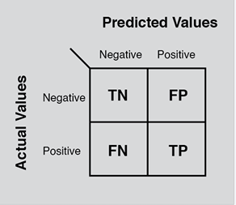
Confusion Matrix
Explanation:
Examining the confusion matrix, we see that logistic regression can distinguish between the different classes. We see that the major problem is false positives.
44

Slide 45
Conclusions
Decision Tree Model is the best algorithm for this dataset.
Launches with a low payload mass show better results than launches with a larger payload mass.
Most of launch sites are in proximity to the Equator line and all the sites are in very close proximity to the coast.
The success rate of launches increases over the years.
KSC LC-39A has the highest success rate of the launches from all the sites.
Orbits ES-L1, GEO, HEO and SSO have 100% success rate.
45

Slide 46
Appendix
Special Thanks to:
Instructors
Coursera
IBM
46
Notes:
46

Slide 47


